Slide 1
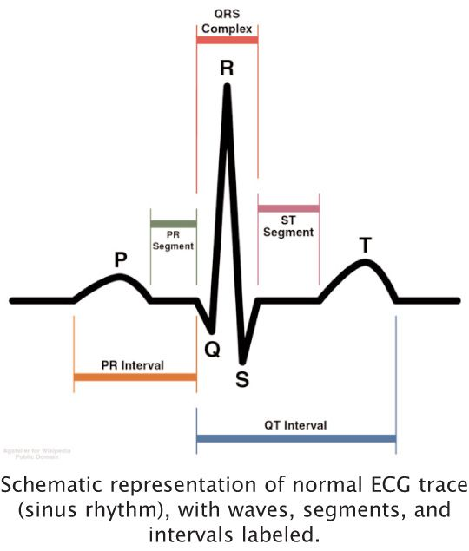
GFPOP in Detecting Fiducial Points of ECG
Atiyeh Fotoohinasab
18 September

Slide 2
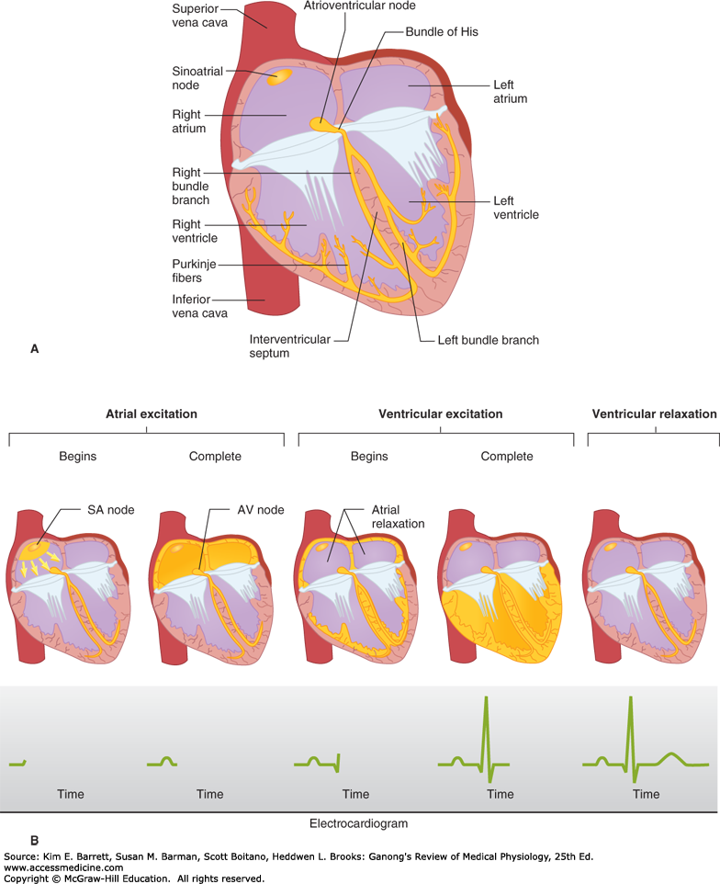
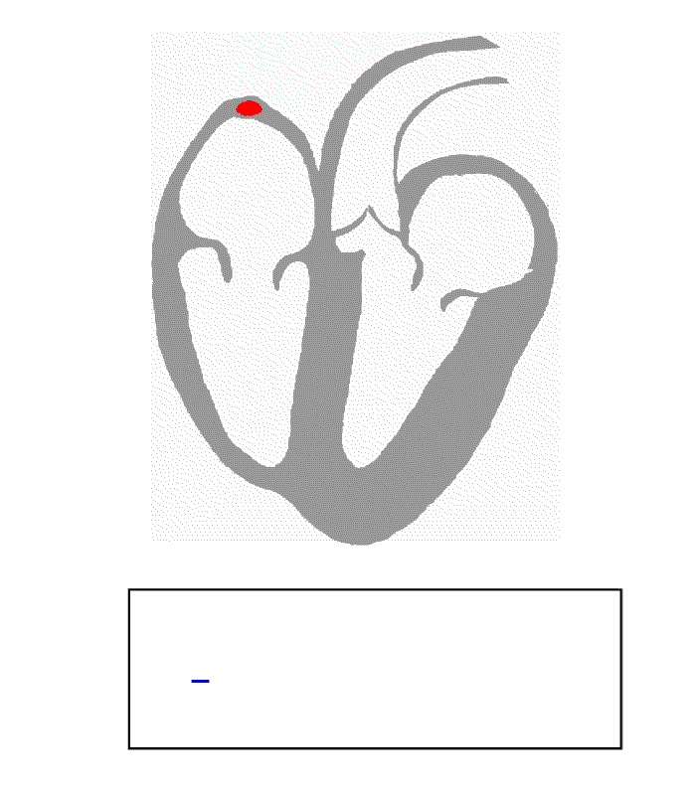
Electrocardiography(ECG)

Slide 3


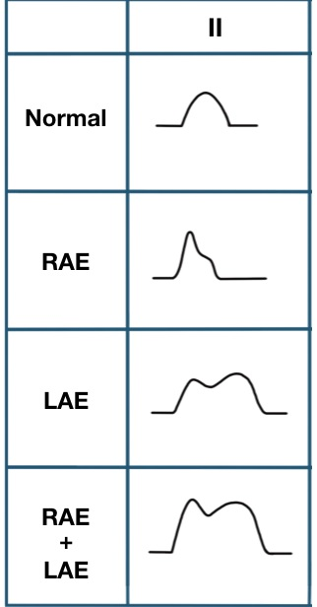
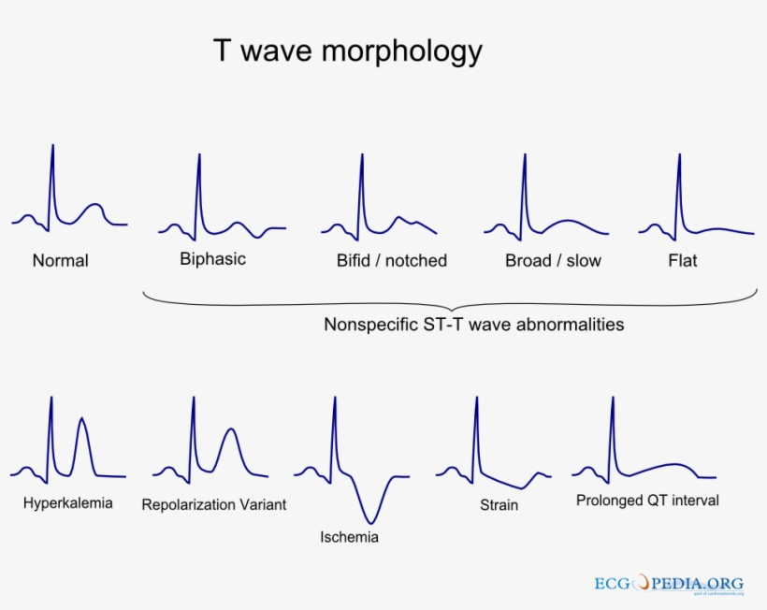
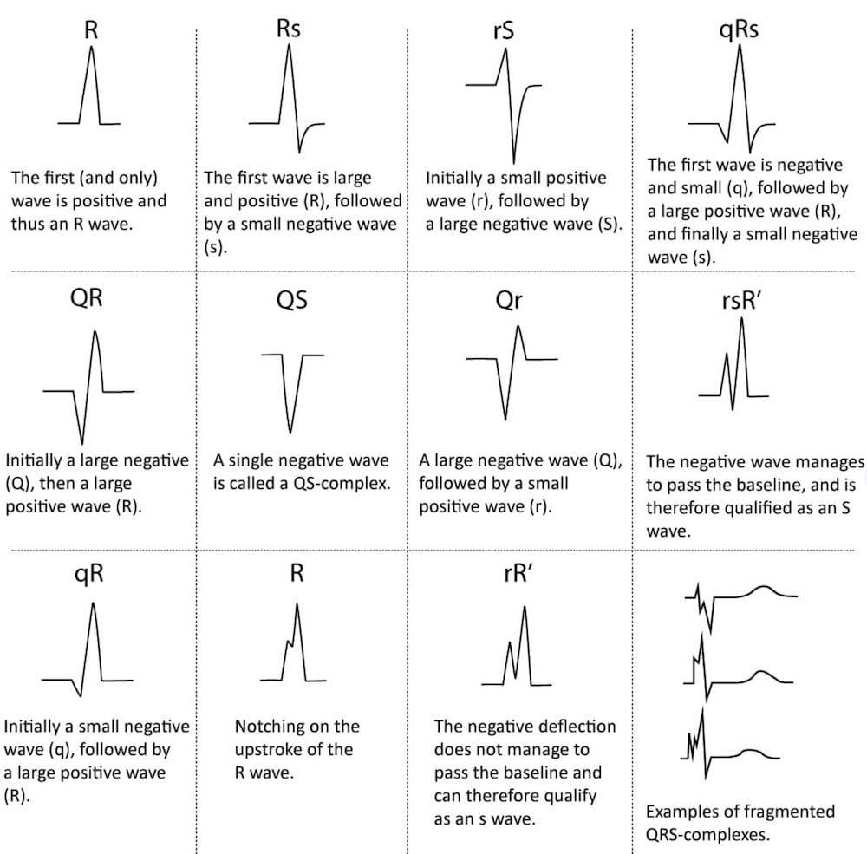
ECG Morphologies
QRS-complex morphologies
P wave morphologies

Slide 4
Graph-Constrained Changepoint Detection
GFPOP
(Generalized Functional
Pruning Optimal
Partitioning Solvers)
Graph
Fiducial points
ECG

Slide 5
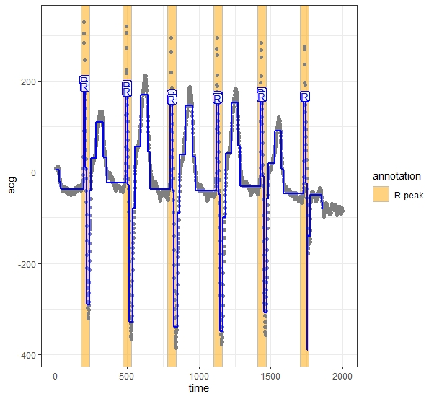
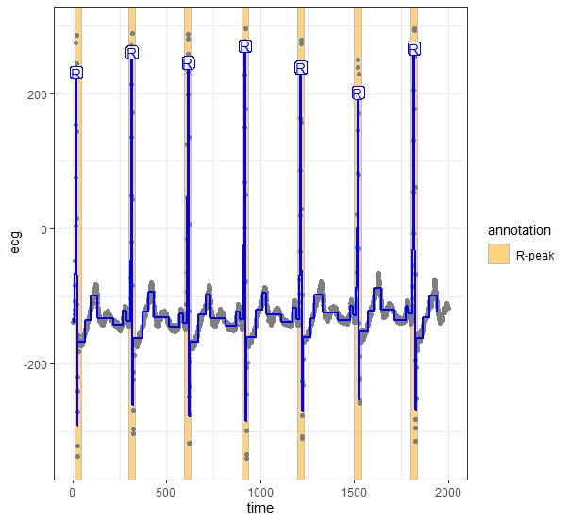
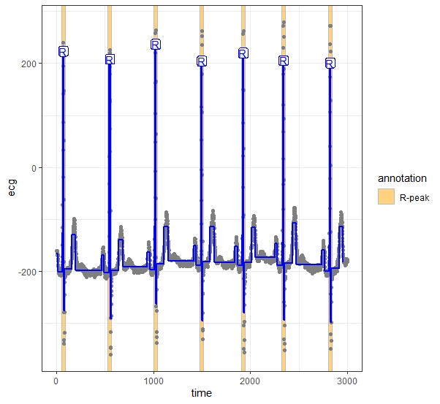
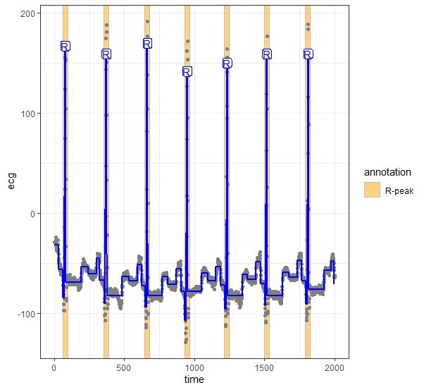
Results
Patient 207
Patient 106
Patient 220
Patient 100

Slide 6

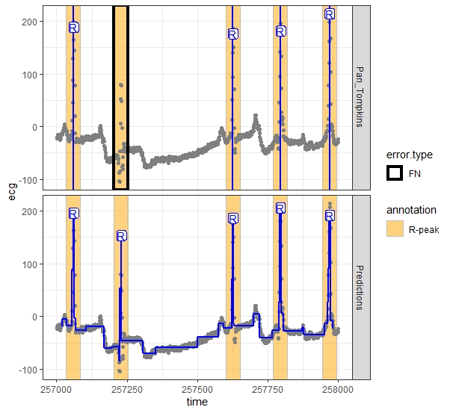
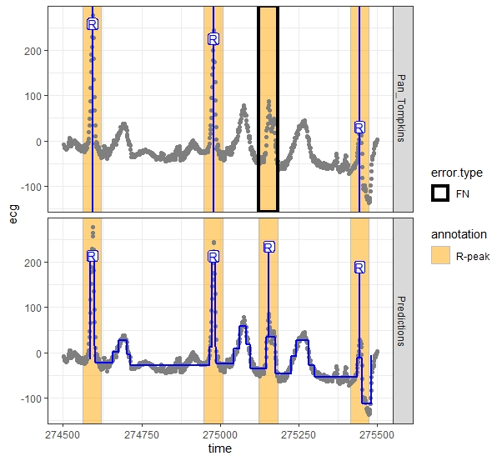
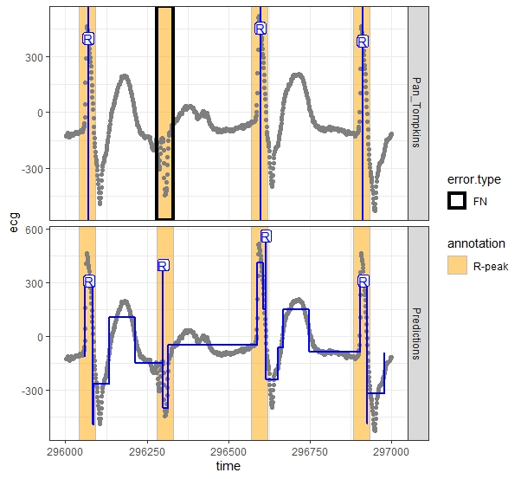
Results
Patient 222 (qR pattern)
Patient 202 (R pattern)
Patient 107 (QS pattern)

Slide 7
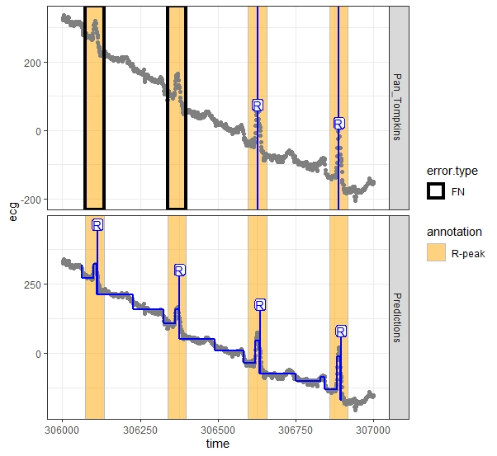
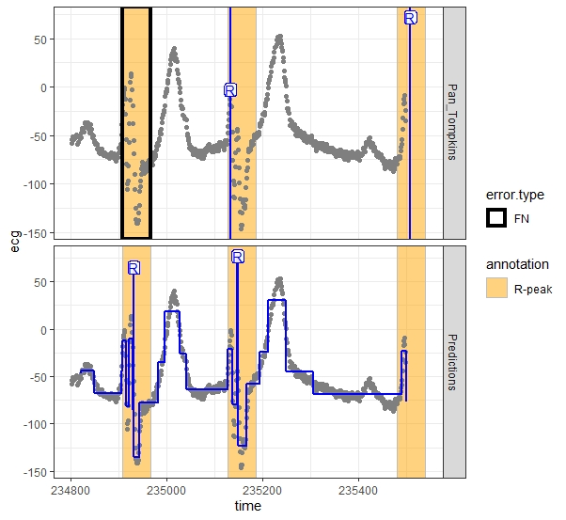
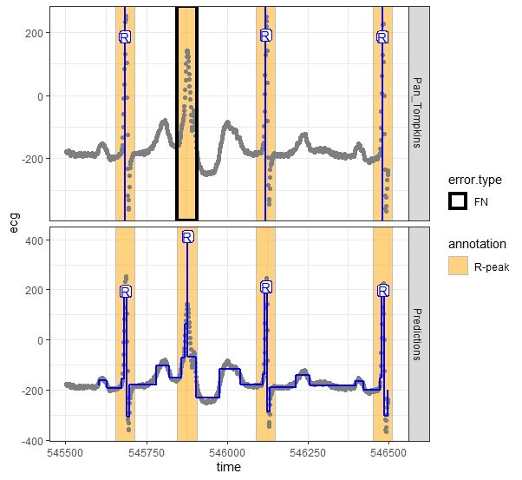
Results
Patient 105 (R pattern)
Patient 111 (Rs pattern)
Patient 123 (Rs pattern)

Slide 8
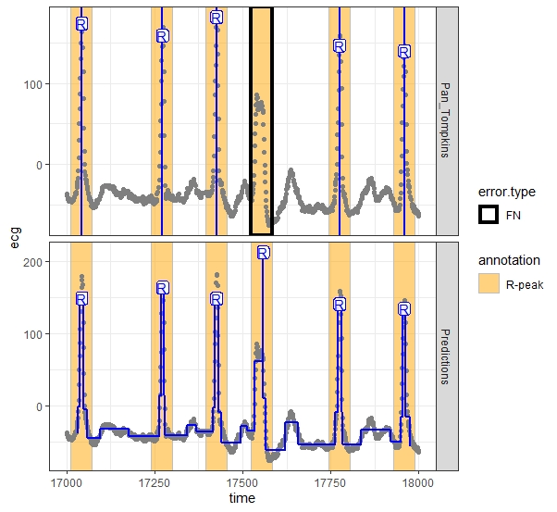
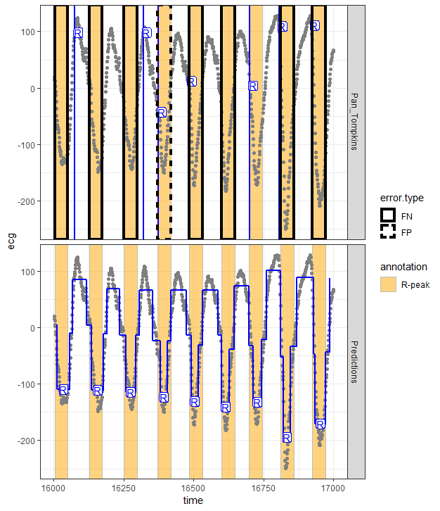
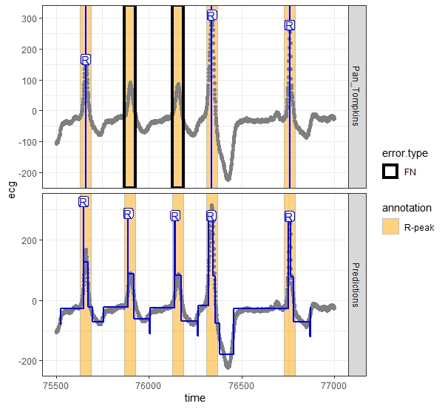
Results
Patient 201 (Rs pattern)
Patient 207 (qs pattern)
Patient 214 (Rs pattern)

Slide 9
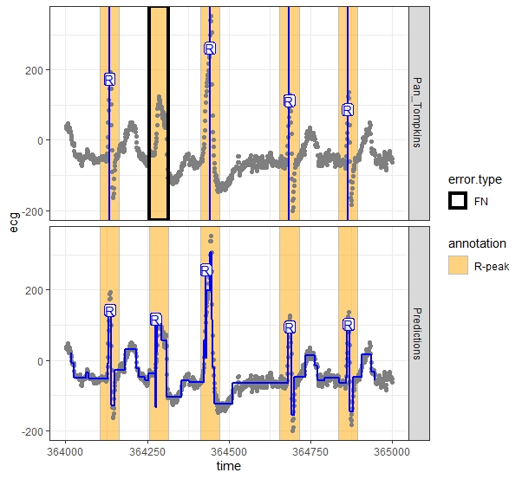
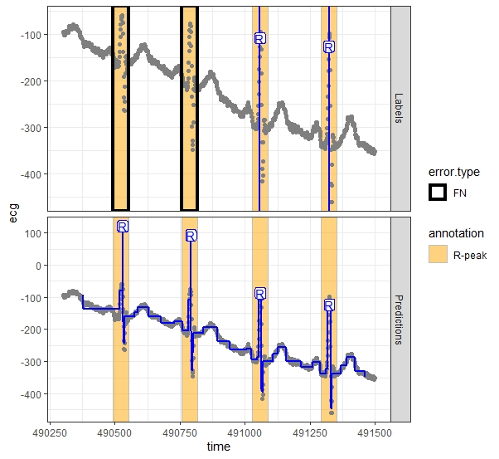
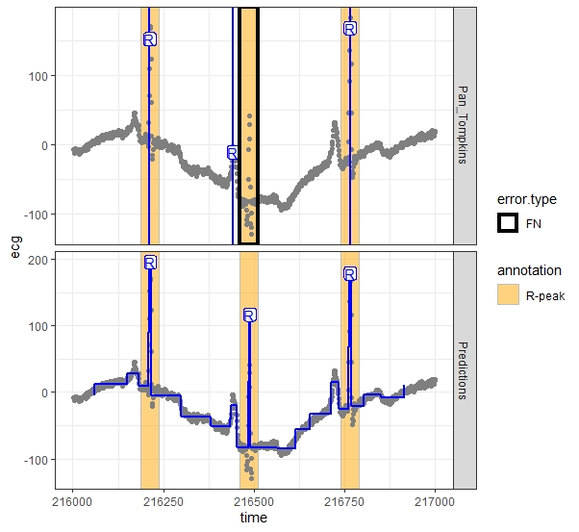
Results
Patient 215 (Rs pattern)
Patient 216 (Rs pattern)
Patient 222 (Rs pattern)

Slide 10
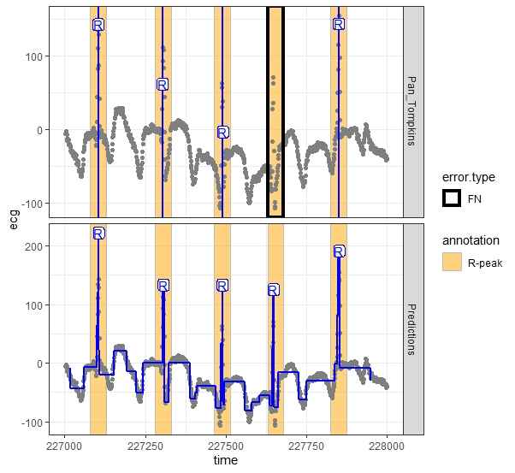
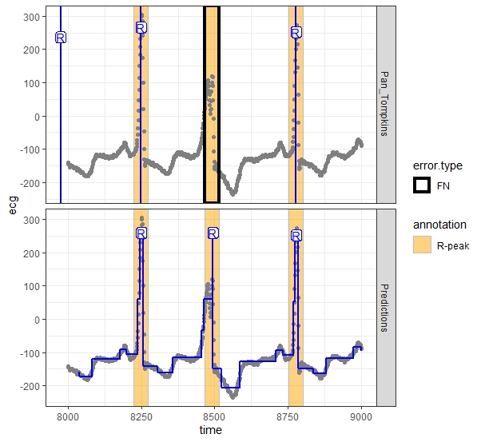
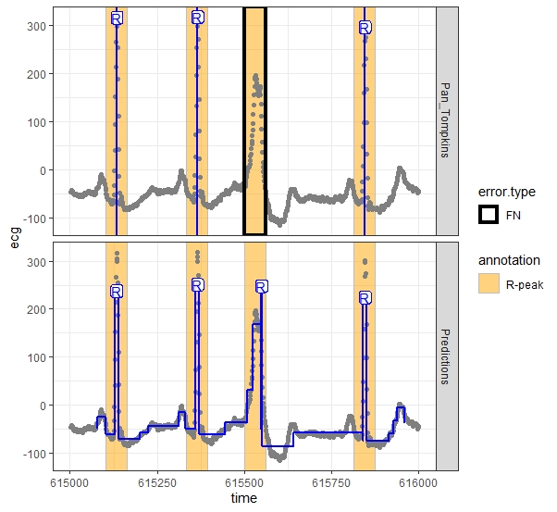
Results
Patient 222 (Rs pattern)
Patient 223 (Rs pattern)
Patient 234 (Rs pattern)

Slide 11
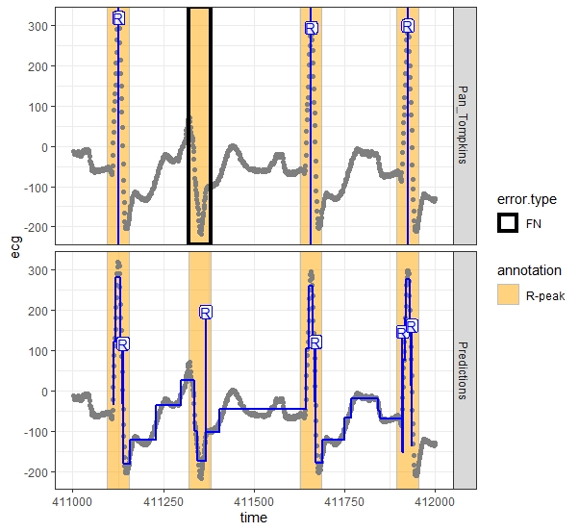
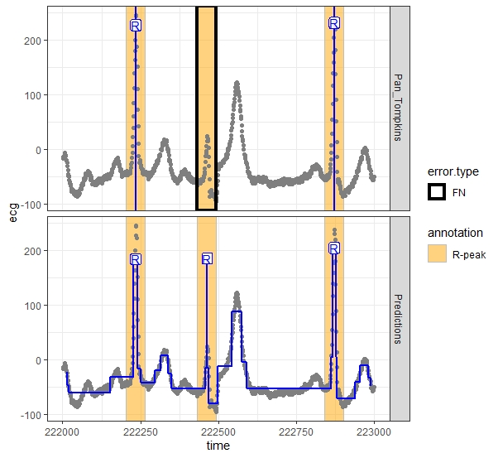
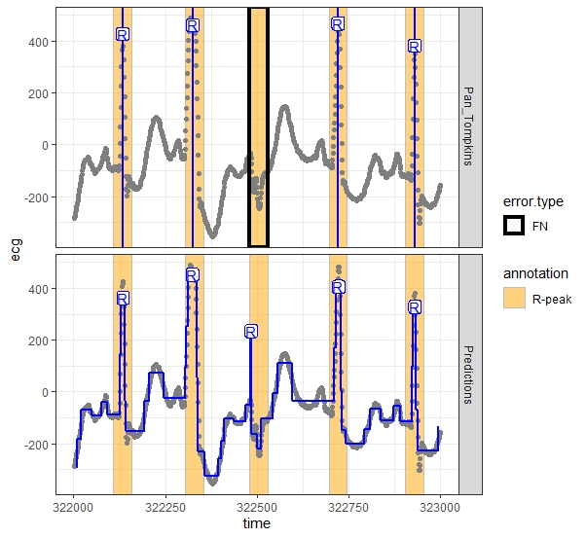
Results
Patient 222 (Rs pattern)
Patient 202 (rs pattern)
Patient 213 (rs pattern)

Slide 12
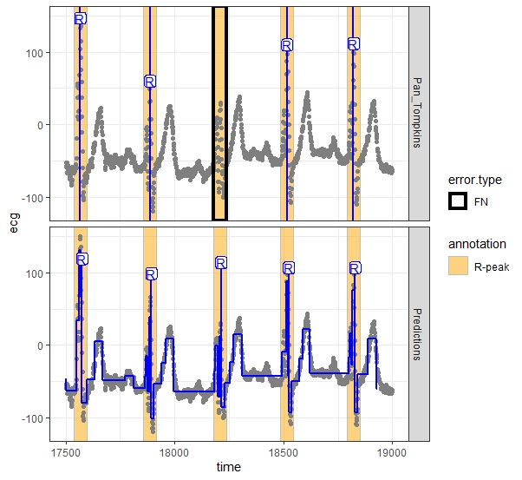
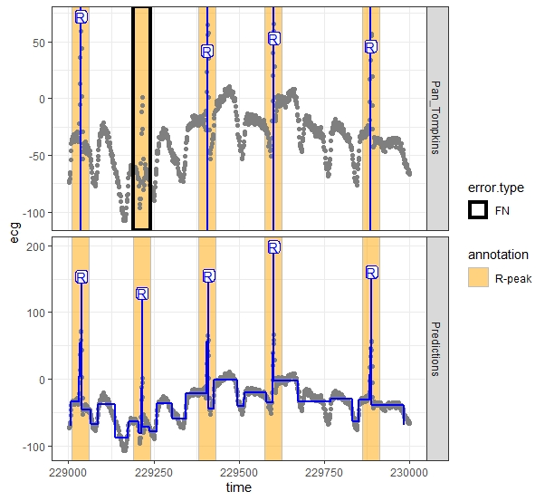
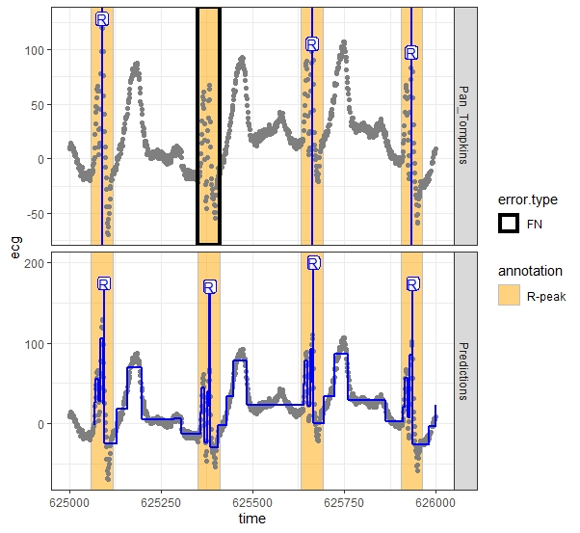
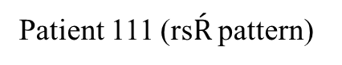
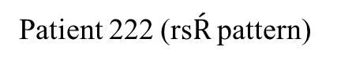
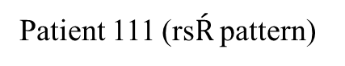
Results
Patient 111 (rs$\acute{R}$ pattern)
Patient 222 (rs$\acute{R}$ pattern)
Patient 111 (rs$\acute{R}$ pattern)

Slide 13
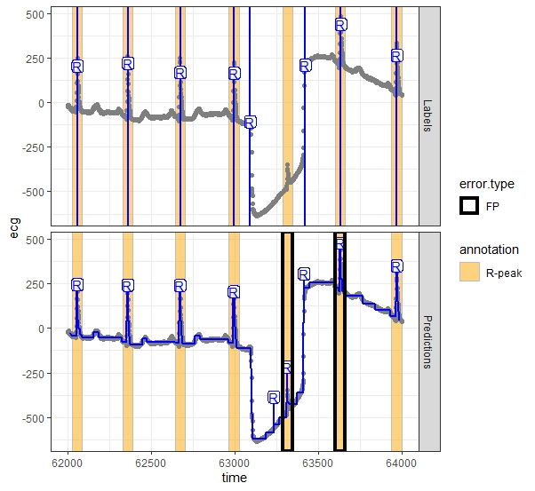
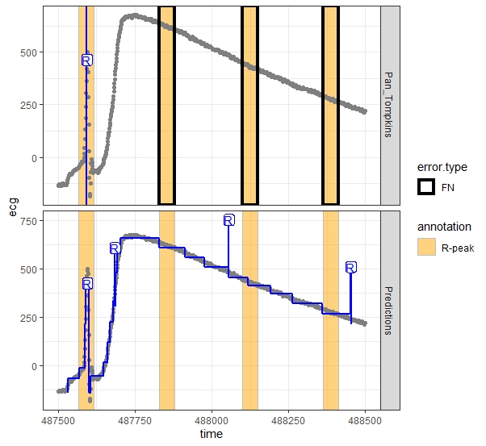
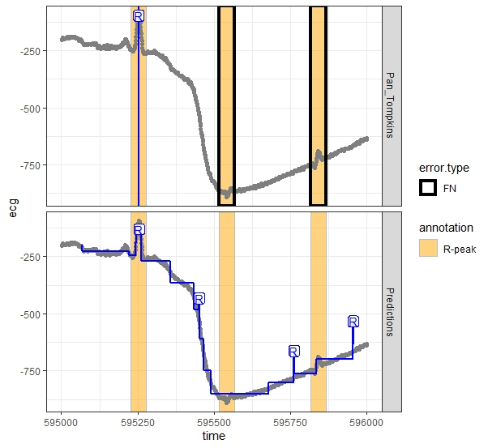
Results
Patient 101
Patient 116
Patient 121

